Slide 1
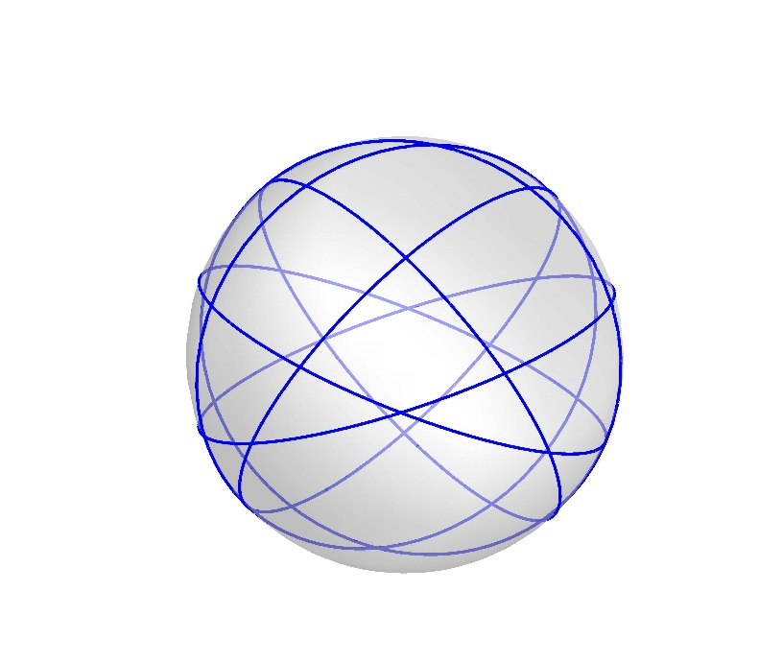
Great Circles Problem
Kha Man
03/14/2015

Slide 2
Outline
The transition of a graph by adding a circle
A base case to color a new graph with a new additional circle
A case where the coloring rule doesn’t work

Slide 3
One approach to solve the problem
Since we’ve already known that coloring 4-regular planar graph is NP-complete and we hope to achieve the chromatic number as 3, it’s not a good idea to start coloring a new graph instead of making induction from some graphs we currently have.
My idea is to use Kempe chain, so if I the graph at the beginning, I may not control all the chains with various lengths manually.

Slide 4
Adding a circle

Slide 5
Adding a circle
This part presents how a graph is changed after adding a random great circle into it
I will show the transitions from graphs of 5, 6 great circles to 6, 7 great circles respectively

Slide 6
5->6 great circles

Slide 7
6->7 great circles - 1

Slide 8
6->7 great circles - 2

Slide 9
6->7 great circles - 3

Slide 10
6->7 great circles - 4

Slide 11
6->7 great circles - 5

Slide 12
6->7 great circles - 6

Slide 13
6->7 great circles - 7

Slide 14
6->7 great circles - 8

Slide 15
6->7 great circles - 9

Slide 16
6->7 great circles - 10

Slide 17
6->7 great circles - 11

Slide 18
A base case

Slide 19
Adding a random great circle
Before discussing this topic, I want to make an example with a graph of 6 great circles as a base case
I get this graph in the slide Presentation 02-20-2015, pp. 7. It’s 1 of 4 non-isomorphic graphs in 1000 that I generated

Slide 20
Adding a random great circle
Now, I try to add one more great circle C_{add} into the graph. The graph on the right is one case of doing that. C_{add} is the circle has white edges and vertices
In this graph, C_{add} simply intersects other great circles but doesn’t change the bounded cycle which is the biggest hexagonal. In other words, there is no edge on C_{add} is in the bounded cycle (the other cases will be mentioned later)

Slide 21
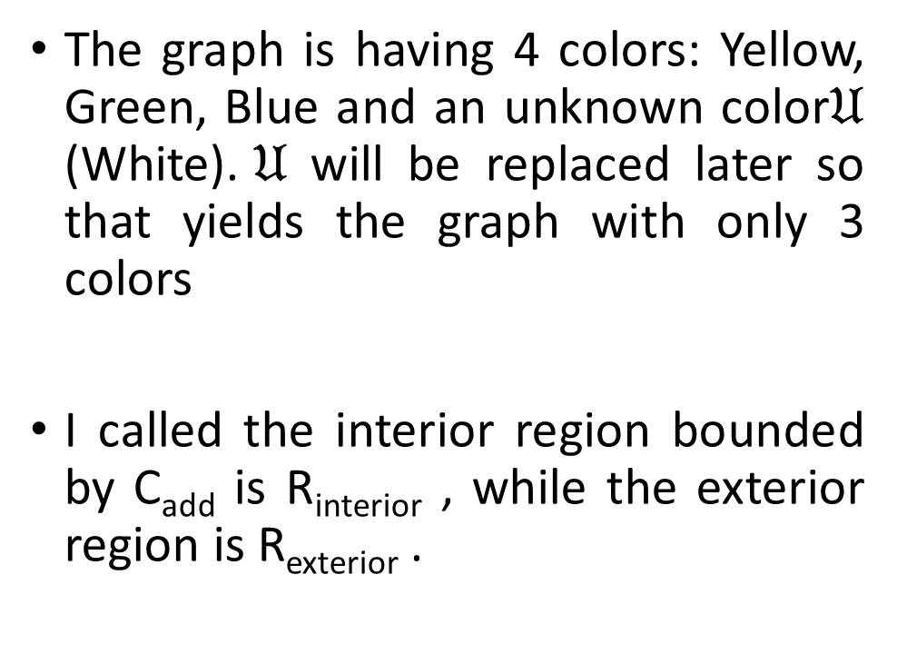
Adding a random great circle
The graph is having 4 colors: Yellow, Green, Blue and an unknown color$𝔘$ (White).$𝔘$ will be replaced later so that yields the graph with only 3 colors
I called the interior region bounded by C_{add} is R_{interior} , while the exterior region is R_{exterior} .

Slide 22
Adding a random great circle
I highlight edges in every great circle by different colors

Slide 23
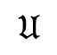

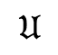
Rule to color $𝔘$
R_{exterior}
$$𝔘$$
Call V is the vertex I want to color. If there is a color available in 3 colors for V, use it. If not, go to the step 2.
2
V
1
R_{interior}
Not 3
R_{exterior}
$$𝔘$$
1
V
1
R_{interior}
Not 3

Slide 24
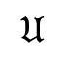
Rule to color $𝔘$
2. Call V_{ext} is the neighboring vertex of V in R_{exterior} , V_{int} is the neighboring vertex of V in R_{interior}
If 3 colors are used and there is a neighboring vertex isn’t colored yet, we have 3 subcases:
2.1. Case 1:
If there is no cycle or an even cycle that include 1-2 Kempe chain starting at V, do 1-2 Kempe chain switch at V
2.2. Case 2:
If there is an odd cycle that include 1-2 Kempe chain starting at V, do 1-3 Kempe chain switch at V
2.2. Case 3:
If there is an odd 1-2 chain and 1-3 chain, switch 2-3 at V_{ext}
R_{exterior}
$$𝔘$$
3
V_{ext}
V
V_{int}
1
R_{interior}
2

Slide 25
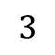
Rule to color $𝔘$
3. Case 3 and other possible cases haven’t any clear solutions yet.
I met some problems which I can’t use any rule to solve them. Therefore, I may update this rule later and try to prove it.
R_{exterior}
$$3$$
2
V
1
R_{interior}
Not 3

Slide 26
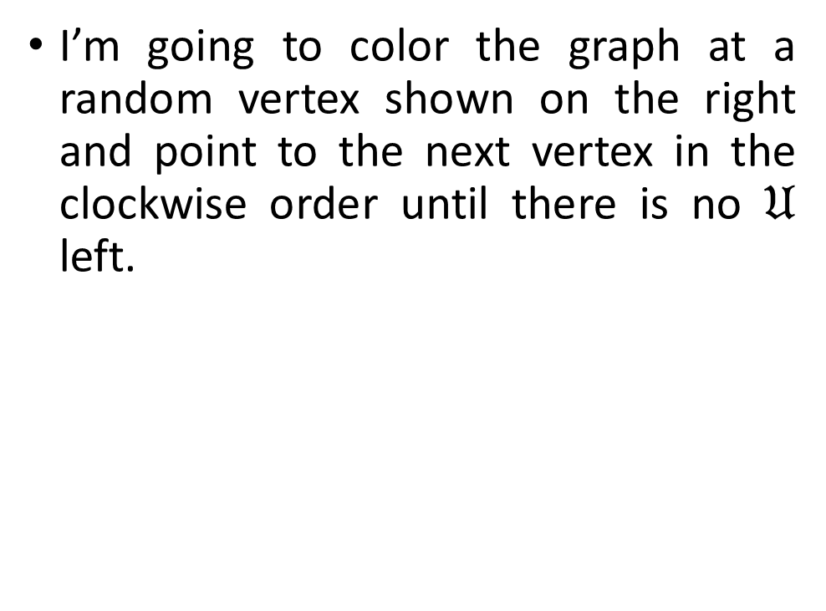
Adding a random great circle
I’m going to color the graph at a random vertex shown on the right and point to the next vertex in the clockwise order until there is no $𝔘$ left.
Start coloring at this vertex

Slide 27
Adding a random great circle
I use Yellow because the neighboring vertices only use 2 colors.
Coloring this vertex

Slide 28
Adding a random great circle
Coloring this vertex
Go to the next vertex, here is the case when 3 colors have been used already.
According to the rule, I will use Green to color.

Slide 29
Adding a random great circle
Coloring this vertex
Go to the next vertex, here is the case when 3 colors have been used already.
According to the rule, I will use Green to color.

Slide 30
Adding a random great circle
Coloring this vertex
The red polygon shows that I can’t do Green-Yellow switch starting at V because there is an odd Green-Yellow cycle there.
Therefore, I will do Green-Blue switch and that switch will only change some vertices on R_{exterior} . Obviously, the Green-Yellow cycle will prevent Green-Blue chain connecting V from R_{exterior}

Slide 31
Adding a random great circle
Coloring this vertex
The red edges are in Green-Blue chain that I follow to switch.

Slide 32
Adding a random great circle
Coloring this vertex
Go to the next vertex, I use Yellow

Slide 33
Adding a random great circle
Coloring this vertex
Go to the next vertex, I use Blue

Slide 34
Adding a random great circle
Coloring this vertex
Go to the next vertex, I use Green

Slide 35
Adding a random great circle
Coloring this vertex
3 colors are used. As usual, I use Yellow from V_{ext} to V
There is no Green-Yellow cycle, so I will do Green-Yellow switch starting at V

Slide 36
Adding a random great circle
Go to the next vertex, I use Green
Coloring this vertex

Slide 37
Adding a random great circle
3 colors are used. As usual, I use Blue from V_{ext} to V
There is an odd Blue-Green cycle, so I have to switch Blue-Yellow chain starting at V
Coloring this vertex

Slide 38
Adding a random great circle
Coloring this vertex

Slide 39
Adding a random great circle
Go to the next vertex, I use Green
Coloring this vertex

Slide 40
Adding a random great circle
3 colors are used. As usual, I use Yellow from V_{ext} to V
There is an odd cycle Blue-Green, so I have to switch Blue-Yellow chain starting at V
Coloring this vertex

Slide 41
Adding a random great circle
Go to the next vertex, I use Blue
Coloring this vertex

Slide 42
Adding a random great circle
Go to the next vertex, I use Green
DONE!!!
Coloring this vertex

Slide 43
Adding a random great circle
Another case is when C_{add} has an edge on the bounded cycle. Moreover, C_{add} increases 1 more edge on the bounded cycle
Here is the graph supposed to be

Slide 44
Adding a random great circle
Now I’m trying to build the desired graph based on the known graph of 6 circles

Slide 45
Adding a random great circle
I highlight edges in every great circle by different colors

Slide 46
Adding a random great circle
Start coloring this vertex
Remove color of this vertex. If not, I can’t use the rule to complete. You can check this case in the next part where the rule doesn’t work out

Slide 47
Adding a random great circle
Coloring this vertex
Go to the next vertex, I use Yellow

Slide 48
Adding a random great circle
Coloring this vertex
Go to the next vertex, I use Blue

Slide 49
Adding a random great circle
Coloring this vertex
Go to the next vertex, I use Green

Slide 50
Adding a random great circle
Coloring this vertex
3 colors are used, so I will use Blue of V_{ext} for V
Because there is no Blue-Green cycle that starts at V and then returns back to V, so I will do switch Blue-Green chain at V

Slide 51
Adding a random great circle
Conflict!!!
3 colors are used, so I will use Yellow on V_{ext} for V
There is a Yellow-Blue cycle in the graph starting at V if I colored V on Yellow

Slide 52
Adding a random great circle
Coloring this vertex
Therefore, I switch Yellow-Green on V and there is no Yellow-Green cycle at V

Slide 53
Adding a random great circle
Coloring this vertex
3 colors are used, so I will use Blue on V_{ext} for V.
There is no Blue-Yellow cycle at V.

Slide 54
Adding a random great circle
Coloring this vertex
3 colors are used, so I will use Yellow on V_{ext} for V.
However, there is a Yellow-Blue starting at V – the previous pointed vertex – V, so I will switch Yellow-Green on V

Slide 55
Adding a random great circle
Coloring this vertex
There is no Yellow-Green cycle at V

Slide 56
Adding a random great circle
Coloring this vertex
Go to the next vertex, there is no available color for V also.
I use Blue on V_{ext} for V and there is no Blue-Yellow cycle at V

Slide 57
Adding a random great circle
Coloring this vertex
Go to the next vertex, V uses Green on V_{ext} and there is no Green-Blue cycle at V

Slide 58
Adding a random great circle
Coloring this vertex
Go to the next vertex, V uses Yellow on V_{ext} and there is no Yellow-Green cycle at V

Slide 59
Adding a random great circle
Coloring this vertex
Go to the next vertex, we have a new case. V_{ext} and the previous pointed vertex have the same color, so we can’t use Yellow-Yellow because this chain only contain 1 color.
Therefore, I will do switch Yellow-Green on V and there is even cycle Yellow-Green at V.
If there is such a case that this Yellow-Green cycle has odd length, so I will use Blue for V and switch Blue-Yellow chain on V. There must be no Blue-Yellow cycle at V because Yellow-Green cycle has blocked 1 possible way to go back to V

Slide 60
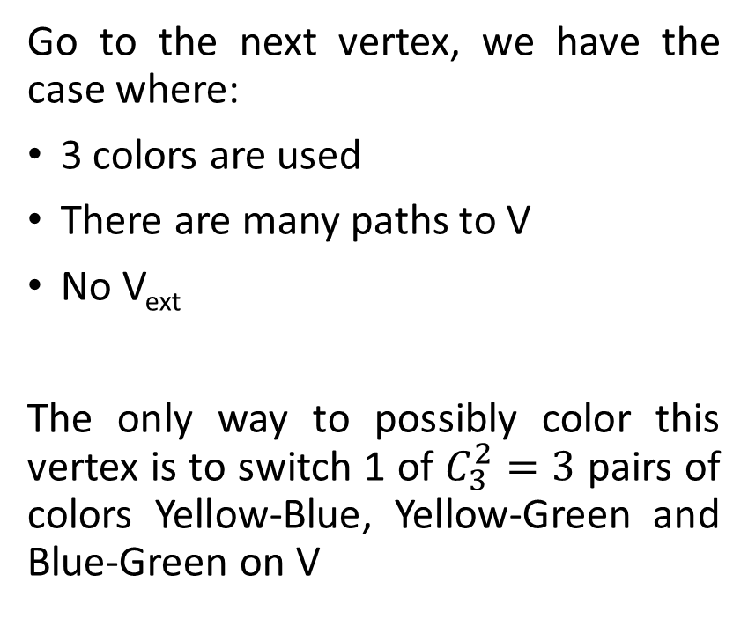
Adding a random great circle
Coloring this vertex
Go to the next vertex, we have the case where:
3 colors are used
There are many paths to V
No V_{ext}
The only way to possibly color this vertex is to switch 1 of $C_{3}^{2}=3$ pairs of colors Yellow-Blue, Yellow-Green and Blue-Green on V

Slide 61
Adding a random great circle
Coloring this vertex
Try Yellow-Blue chain first. I will use Blue for V and do switch Yellow-Blue chain at V
Unfortunately, there are 2 Green-Blue cycles with odd lengths at V. Therefore, I need to use another chain

Slide 62
Adding a random great circle
Coloring this vertex
However, switching Yellow-Green chain on V can be done because Yellow-Blue blocked out all the possible paths to V
DONE!!!

Slide 63
A case where the coloring rule doesn’t work

Slide 64
Adding a random great circle
Start coloring this vertex
I will start coloring at the vertex like the figure. Green is used because the neighboring vertices only use Yellow and Blue

Slide 65
Adding a random great circle
Coloring this vertex
Go to the next vertex, I use Yellow

Slide 66
Adding a random great circle
Coloring this vertex
Go to the next vertex, I use Blue

Slide 67
Adding a random great circle
Coloring this vertex
Go to the next vertex, I use Blue

Slide 68
Adding a random great circle
Coloring this vertex
3 colors are used, so I will use Blue of V_{ext} for V and do switch Blue-Green chain on V
There is no Blue-Green cycle at V

Slide 69
Adding a random great circle
Coloring this vertex
3 colors are used, so I will use Yellow of V_{ext} for V and do switch Yellow-Blue chain on V
There is no Yellow-Blue cycle at V

Slide 70
Adding a random great circle
Coloring this vertex
Go to the next vertex, I use Blue

Slide 71
Adding a random great circle
Conflict!!!
3 colors are used, so I will use Yellow of V_{ext} for V
However, there is an odd Yellow-Blue cycle at V.

Slide 72
Adding a random great circle
Coloring this vertex
Therefore, I will switch Yellow-Green chain at V.

Slide 73
Adding a random great circle
Conflict!!!
Go to the next vertex, here is the most difficult case!!!
3 colors are used, so I will use Blue of V_{ext} for V
However, there is an odd Yellow-Blue cycle at V.

Slide 74
Adding a random great circle
Conflict!!!
Try Blue-Green on V but there is an odd Blue-Green cycle at V

Slide 75
Adding a random great circle
Therefore, I keep Blue on V, replace V_{ext} to Yellow and switch Yellow-Green at V_{ext}

Slide 76
Adding a random great circle
Coloring this vertex
Go to the next vertex, 3 colors are used, so I will use Yellow of V_{ext} for V and do switch Yellow-Blue at V
However, there is a odd Yellow-Blue cycle at V

Slide 77
Adding a random great circle
Coloring this vertex
Hence, I switch Yellow-Green at V. However, there is a odd Yellow-Green cycle at V

Slide 78
Adding a random great circle
Coloring this vertex
So, I still keep Yellow on V but replace V_{ext} to Blue and switch Blue-Green at V_{ext}
Luckily, there is an even Blue-Green cycle at V_{ext}

Slide 79
Adding a random great circle
Coloring this vertex
Go to the next vertex, 3 colors are used, so I will use Green of V_{ext} for V and do switch Green-Yellow at V
However, there is a odd Green-Yellow cycle at V

Slide 80
Adding a random great circle
Coloring this vertex
Hence, I switch Green-Blue at V. However, there is a odd Green-Blue at V

Slide 81
Adding a random great circle
Conflict made by Kempe chain switch
I still keep Green on V, but replace V_{ext} to Yellow and switch Yellow-Blue at V_{ext}
Conflict by changing color of V_{ext} . It can be fixed but the problem is there is a odd Yellow-Blue at V_{ext}

Slide 82
Adding a random great circle
I decided to stop coloring this case after few switches. I may solve that problem easily but it’s not convincing for a the entire proof

